Slide 1

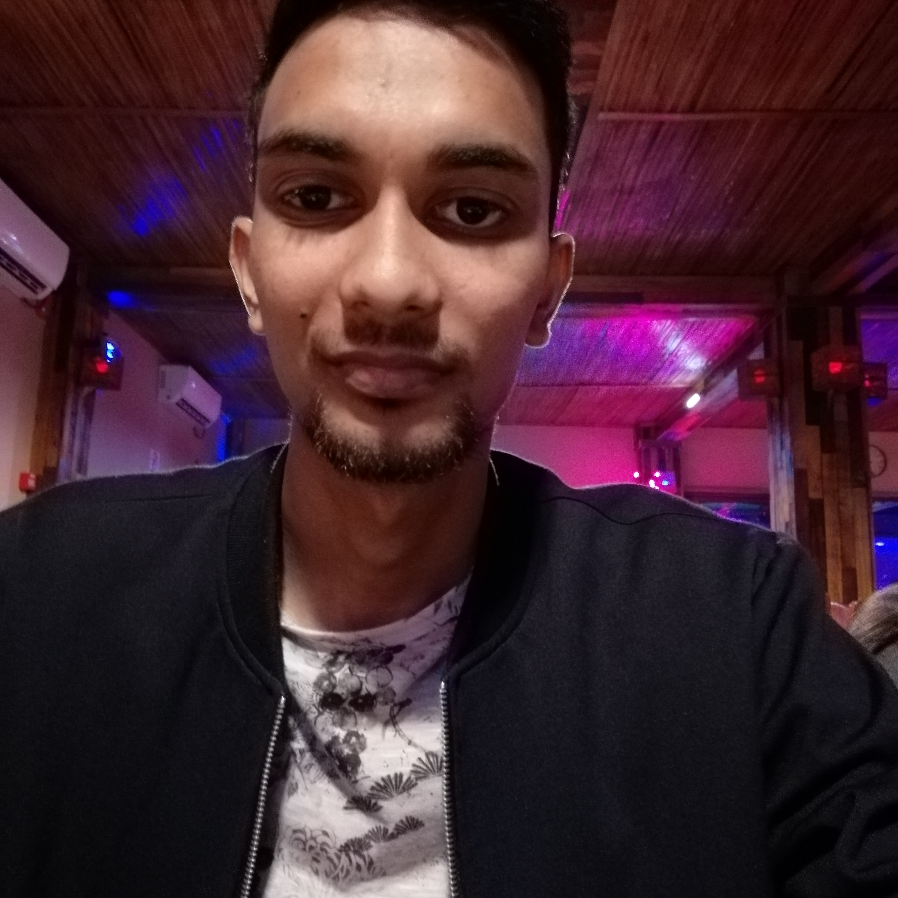
Experience
Areas of expertise
Functional
Full Stack
Agile / Design Thinking
UX / UI
Industries
Finance
Technical
Web (HTML/CSS/JS)
PHP
Java
GIT
SQL(SSMS)
Bootstrap
C-Sharp / ASP.NET
Azure Fundamentals
T-SQL
IoT
Azure
JSON
Adobe Illustrator/XD
Data Engineer (April 2021 - Present)
Microsoft Azure
AZ-900 Certification Training
Software Developer Intern (Nov 2019 – Mar 2020)
Application development using C-Sharp
Pravesh BUSGEETH
Data Engineer
Application Development New Associate Ebène, Mauritius.
Education
Professional background
Diploma in Information Technology – (IoT)
Amity University - 2021
Computer Science graduate with 5 months of experience in application development.
I love to take on new challenges and learn new technologies.

Slide 2

Current Experience
Data Engineer
Skills & Technologies
I am responsible for the following project activities:
Collaborating with the stakeholders to fully understand the requirements and making sure that the features fulfill the business needs.
Working with the different teams (functional and technical) to come up with the proper approach to tackle various design and implementation problems.
Regular demos to the business for the features implemented.
Skills
Teamwork
Communication
Analysis & solutions design
Problem Solving
Quick Learner
Technical
SQL Server Management Studio
Visual Studio
Git
Power BI
JSON
T-SQL

Slide 3
Past Experience
Software Developer Intern – Checkout.com Nov 2019 – Mar 2020
Develop multiple projects using C# programming language
SQL Server at the back-end
Assisted with design and development of projects.
Performed debugging techniques.

